Slide 1


THE INTERNATIONAL AWARD FOR YOUNG PEOPLE
Online Record Book- Participant
ENGAGE | EQUIP | EMPOWER | REWARD

Slide 2

HOW TO REGISTER ON THE ONLINE RECORD BOOK?
Participant
ENGAGE | EQUIP | EMPOWER | REWARD

Slide 3



Step 1: Website – www.onlinerecordbook.org
ENGAGE | EQUIP | EMPOWER | REWARD

Slide 4
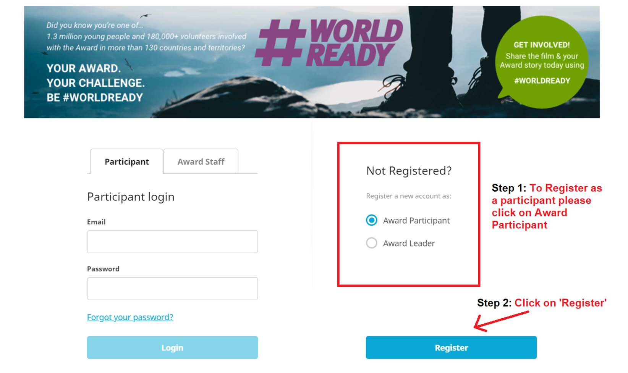
ENGAGE | EQUIP | EMPOWER | REWARD

Slide 5
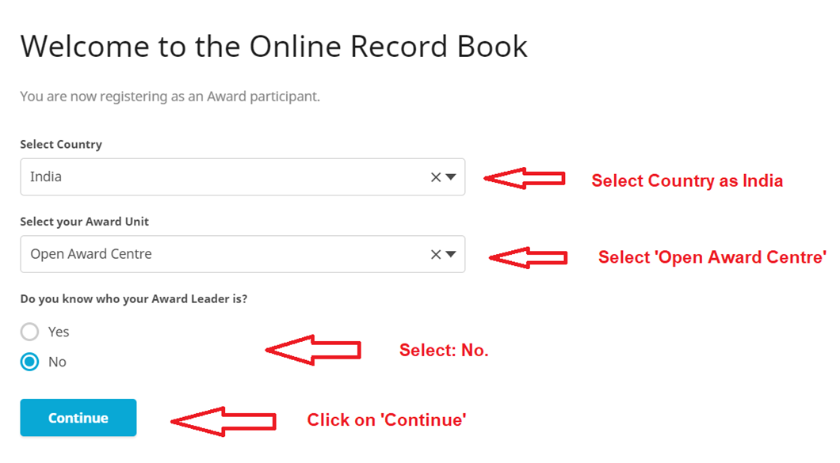

School name
ENGAGE | EQUIP | EMPOWER | REWARD

Slide 6
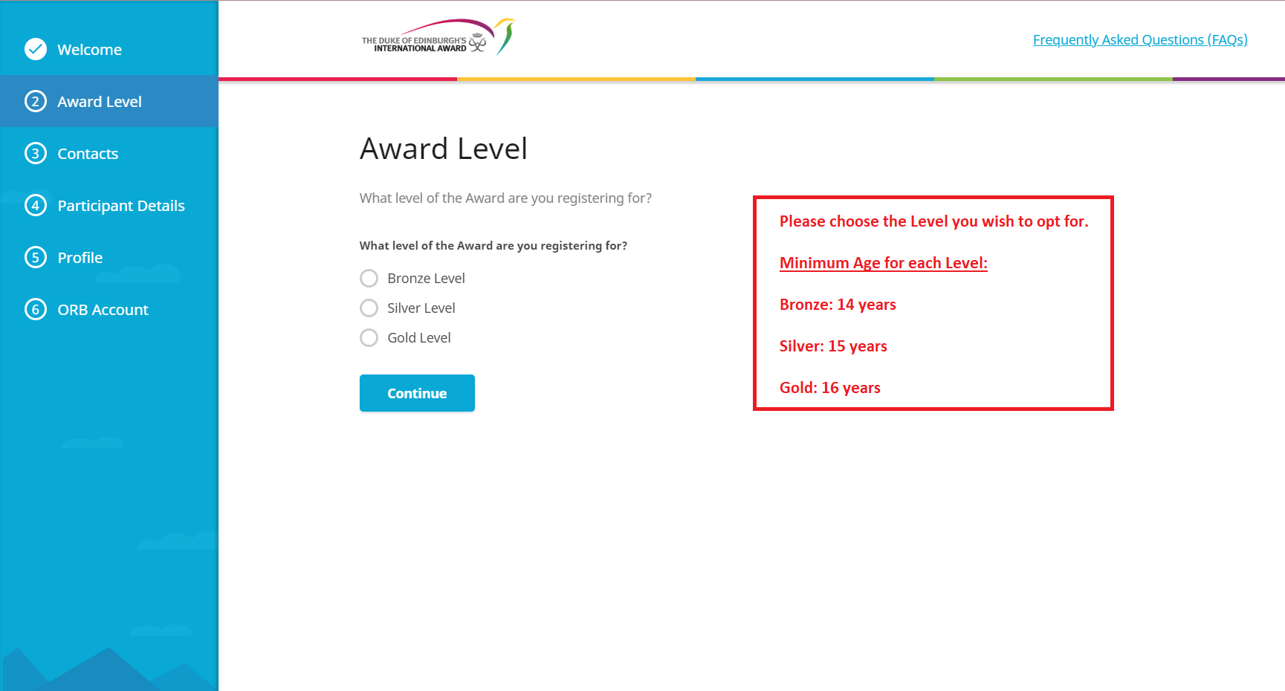
ENGAGE | EQUIP | EMPOWER | REWARD

Slide 7
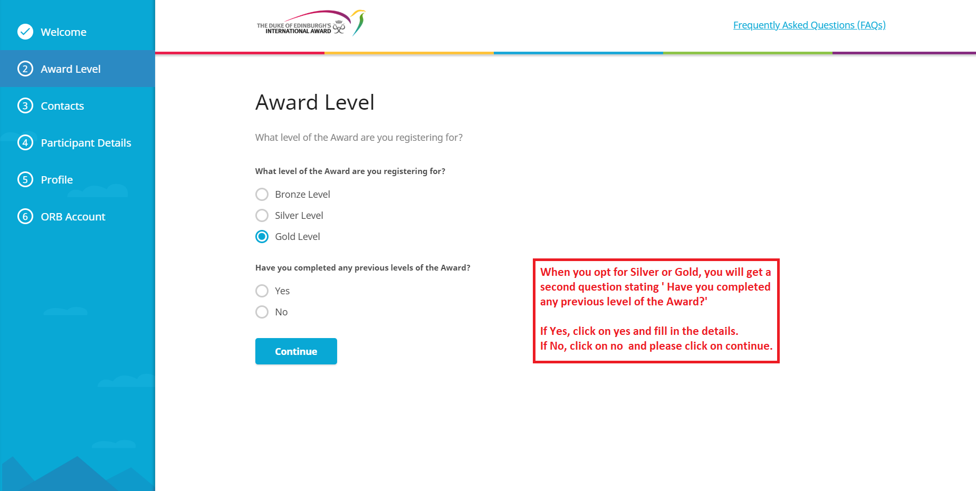
ENGAGE | EQUIP | EMPOWER | REWARD

Slide 8
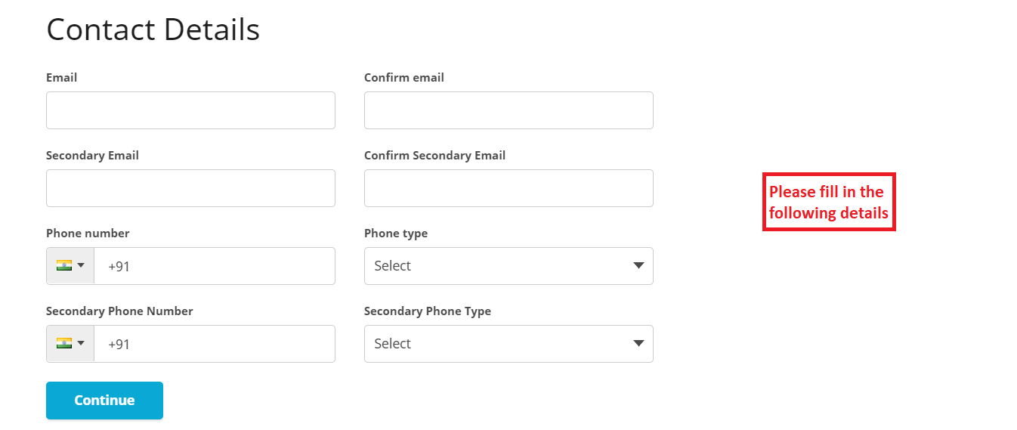
ENGAGE | EQUIP | EMPOWER | REWARD

Slide 9
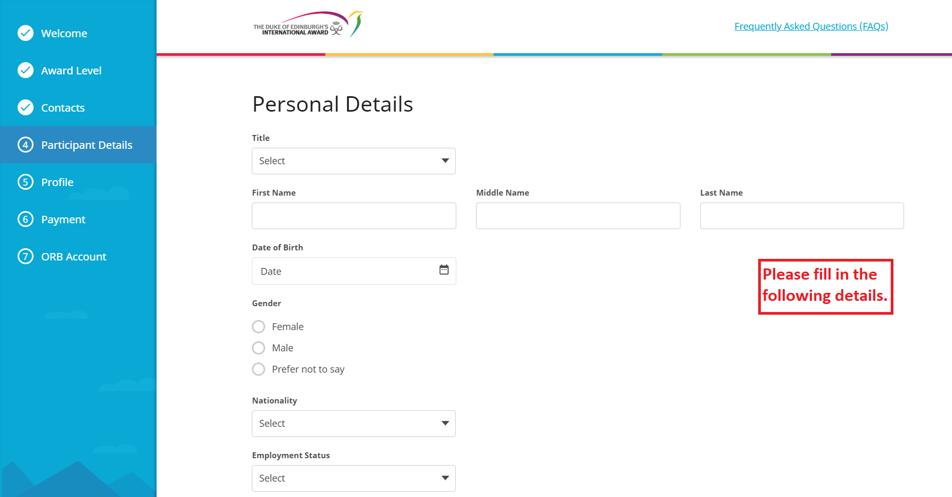
ENGAGE | EQUIP | EMPOWER | REWARD

Slide 10
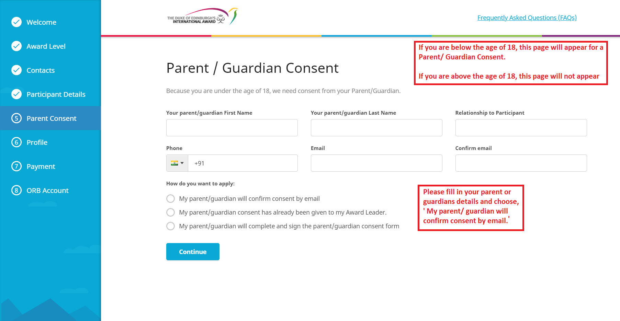
Choose the third option : My parent/guardian will complete and sign the parent/guardian consent form
ENGAGE | EQUIP | EMPOWER | REWARD

Slide 11
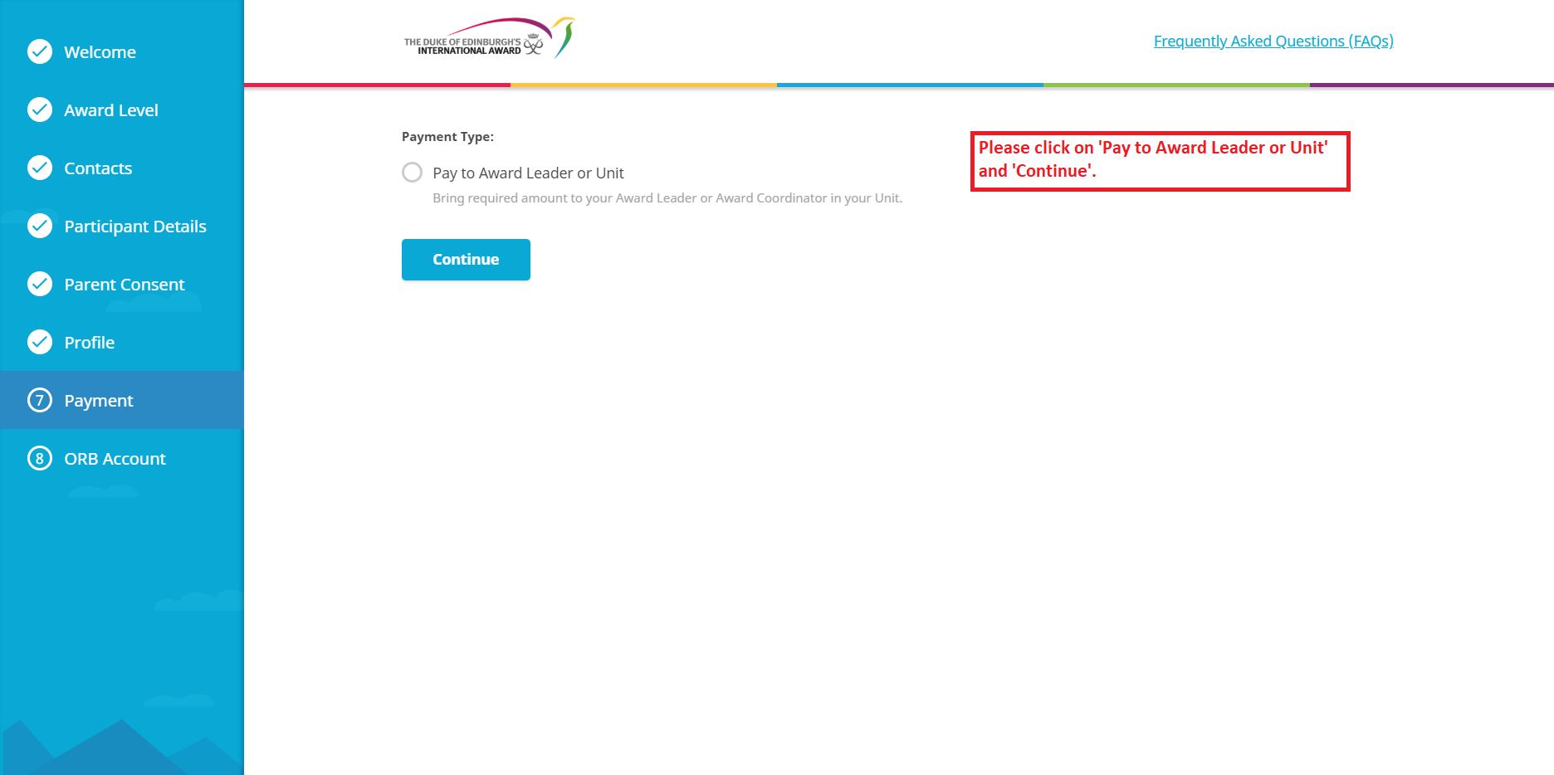
ENGAGE | EQUIP | EMPOWER | REWARD

Slide 12
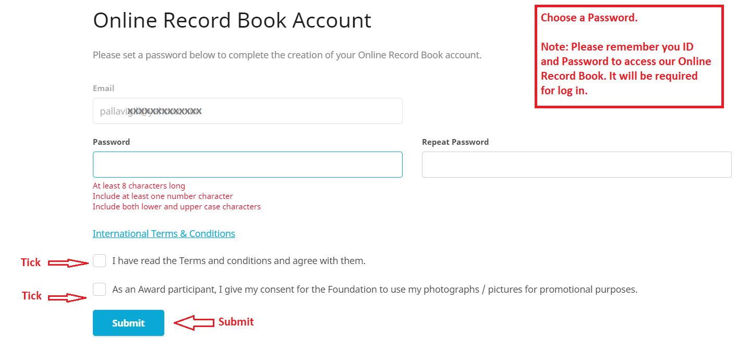
ENGAGE | EQUIP | EMPOWER | REWARD

Slide 13
After completing the registration, please log into your mail and complete the Email ID verification.
ENGAGE | EQUIP | EMPOWER | REWARD

Slide 14
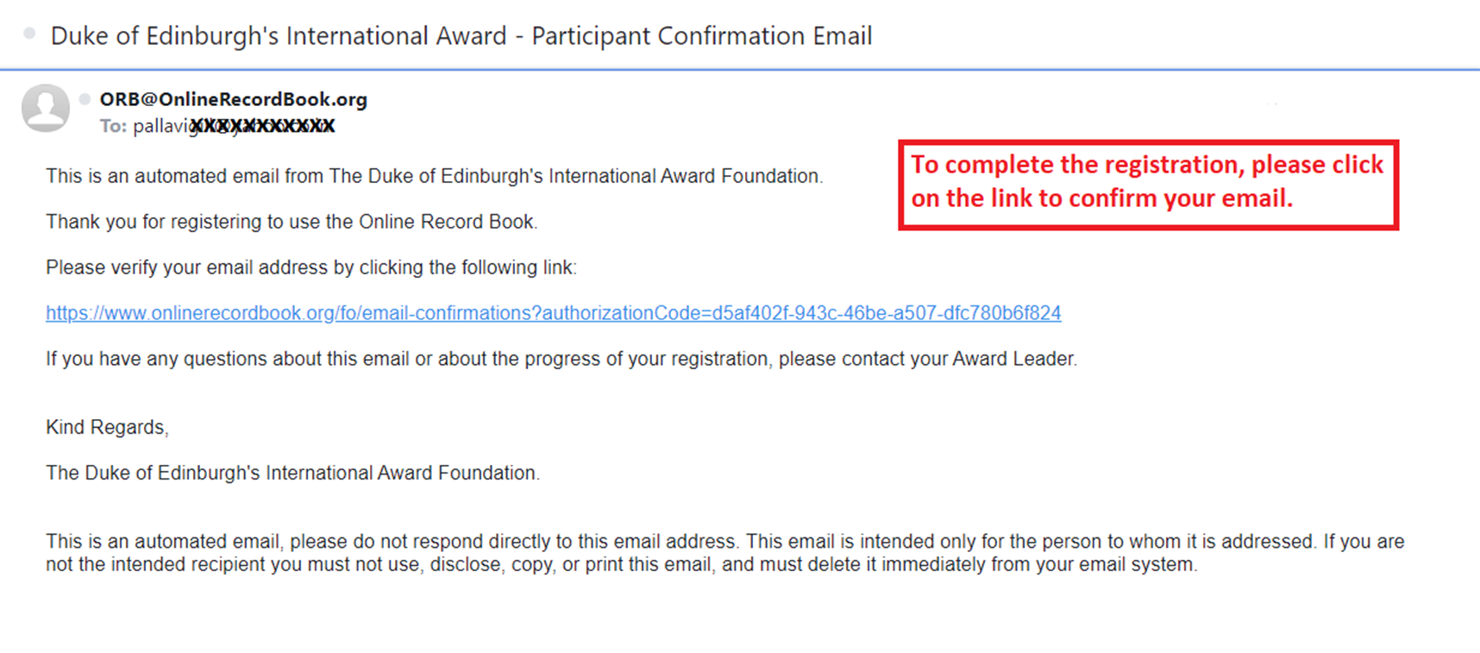
ENGAGE | EQUIP | EMPOWER | REWARD

Slide 15

You will receive a link on your mail for a short survey, please complete the survey.
ENGAGE | EQUIP | EMPOWER | REWARD

Slide 16
Your registration will be approved by the National Office after looking into all the details.
For any assistance please email us at:
askme@dofe.in / bivujit@dofe.in / ankita.gera@dofe.in /
kavitapatil@dofe.in / poojita@dofe.in / tanima@dofe.in
ENGAGE | EQUIP | EMPOWER | REWARD

Slide 17
The International Award for Young People
First Floor, 86/1 Shahpur Jat,
August Kranti Marg, Near Asian Games Village,
New Delhi - 110 049, India
Tel: +91.11.41087062
website : www.iayp.co.in
e-mail : askme@dofe.in
ENGAGE | EQUIP | EMPOWER | REWARD

